Slide 1
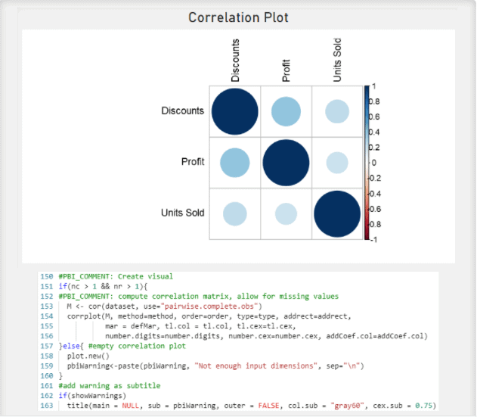
R Script Visual
The R Script Visual uses an R script. It allows you to prepare, analyze, and plot visuals by running R scripts on your dataset directly on the Power BI desktop. However, you can only run R scripts if you have downloaded R to your local computer.

Slide 2
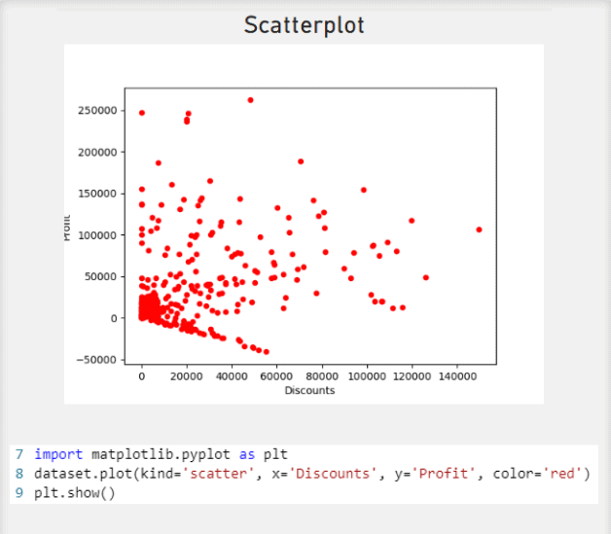
Python Visual
The Python Visual uses the Python programming language. It allows you to prepare, analyze, and plot visuals by running Python scripts on your dataset directly on the Power BI desktop. However, you can only run Python scripts if you have downloaded Python to your local computer.

Slide 3
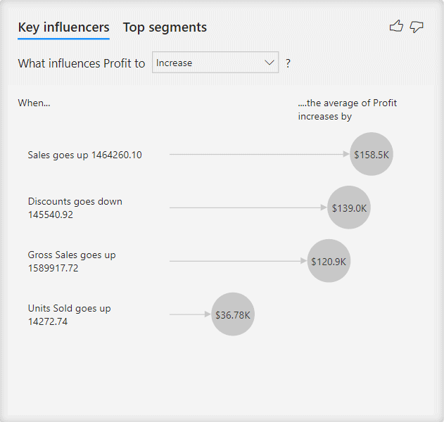
Key Influencers
The Key Influencers visual analyzes the data and ranks in order of factors that matter. Therefore, the factors with the highest correlation are displayed first. Use this visual to understand what factors affect the metric being analyzed or when you want to contrast the relative importance of the factors.

Slide 4
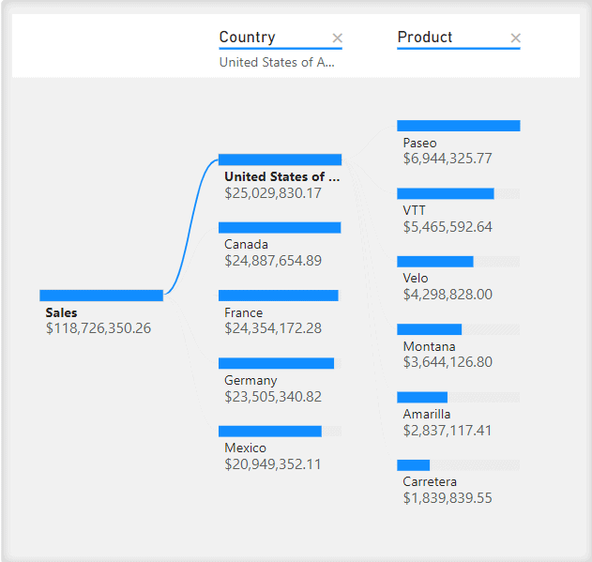
Decomposition Tree
The Decomposition Tree visual displays data across multiple dimensions by aggregating the data for you, enabling you to drill down in any order. It uses artificial intelligence (AI) to find the next dimension to drill down. Use the Decomposition Tree when you want to conduct root cause analysis or ad-hoc exploration.

Slide 5
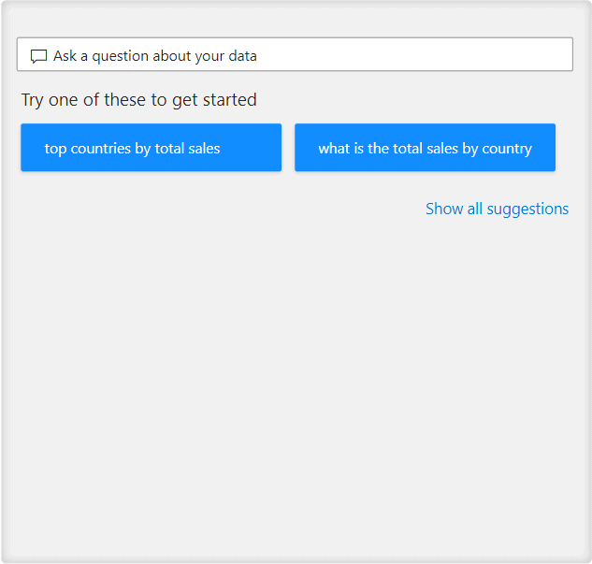
Q&A
The Q&A feature allows you to type a question in the report and receive an answer as a visual. The Q&A engine uses artificial intelligence (AI) to decide which visual to use based on the words in the question.

